Slide 1

WELCOME TO
INVENTORY MANAGEMENT SYSTEM

Slide 2




INTRODUCTION
Altay Yemendzhiev
Kristian Dinev
Artyom Bock
Zlatin Kostov
Scrum
master
Back-end
developer
Back-end
developer
Front-end
developer

Slide 3

OUR MISSION
Lapis Technologies
Lapis Technologies is a desktop application that lets users manage a store inventory, track their stock efficiently, and calculate total values recursively. Users can search for specific products and view important details such as the price and the available quantity.
The app also helps people organize their items in one place. By utilizing smart recursive algorithms, the system automatically calculates the total market value of the inventory, making it easier to run a business with a clean, table-based Graphical User Interface.

Slide 4
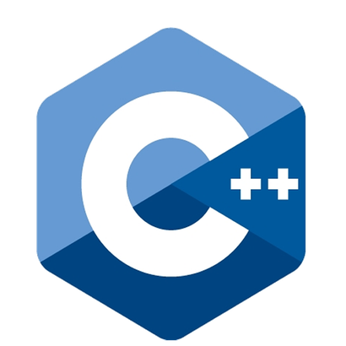






TECH STACK
Lapis technologies

Slide 5
LET’S CONTINUE WITH THE DEMONSTRATION

